Slide 1
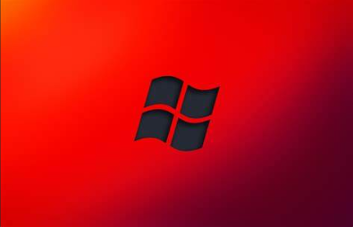
OSphere: Exploring the Windows Universe \
Pitch Deck
20xx
</
} /> [
/>
BY:
Abhibhav Sharma (UE223004)
Aditya Saharan (UE223008)
Aman Kumar (UE223010)
Anurag Kumar Vig (UE223015)
Himesh Arora (UE223040)

Slide 2

</Aim of the project/>
This project aims to research about the most popular operating system in the world, Windows .
How Windows evolved from decade to decade , its architecture ,its inner workings , its backup and security ,
Its explicit features , how it captured the world and the future ahead , all will be covered in this project.

Slide 3
</ Table of contents />
{01}
{04}
Introduction
Features
{02}
{05}
Working
Conclusion
{03}
Security

Slide 4
</Introduction/>
01
Pitch Deck
20xx
1)What is Windows?
2)Evolution of Windows
3)Windows NT
4)Various Windows servers
5)Various Commands on Windows

Slide 5
</What is Windows?/>
Windows is a group of several proprietary graphical operating system families, all of which are developed and marketed by Microsoft. Each family caters to a certain sector of the computing industry . Windows has evolved to meet the diverse needs of users across personal computers, servers, and mobile devices. Offering features such as multitasking, memory management, and device support.
Windows has become synonymous with modern computing, playing a pivotal role in shaping the landscape of operating system The latest version of Windows which is being widely used across the world is Windows 11.

Slide 6
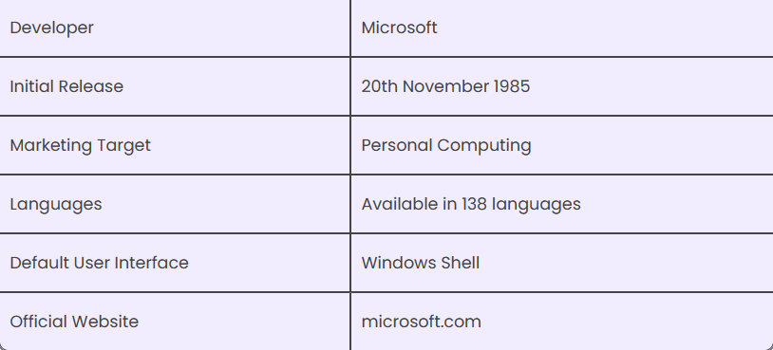
Some useful Information:

Slide 7
</Evolution of Windows/>
Windows have had several versions over the years starting from Windows 1 to the latest Windows 11.
Beginning with Windows XP, Microsoft has distributed different editions of Windows. Every one of these Windows versions has the same core operating system, however, a few releases have extra features, at an extra expense. Microsoft presented an operating environment named Windows on November 20, 1985, as a graphical working framework shell for MS-DOS because of the developing interest for graphical UIs (GUIs).

Slide 8
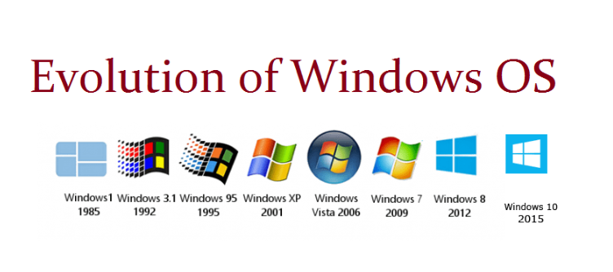
Let us understand the different versions of Windows Operating System along with the features of each of them individually:
1) Windows 1.0
a)It was released on November 20, 1985
b)Pure Operating Environment
c)Used Graphical User Interface
d)Simple Graphics
e)Offered limited multi-tasking was expected to have a better
future potential

Slide 9
2) Windows 2.0
a)It was released on December 9, 1987
b)16-bit Graphic User Interface (GUI) based operating environment
c)Introduced Control Panel, and the first version of MS Word and Excel
d)Unlike Windows 1.0, it had the capacity to allow applications to overlap each other
e)It was also the last Windows OS which did not require a hard disk
f)Hardware played an important role
3) Windows 3.0
a)It was released in 1990
b)It was better at multitasking
c)Used 8086 microprocessors
d)It has both, conventional and extendable memory
e)First version of Windows to gather critical appreciation
f)Better memory/ storage

Slide 10
4) Window 95
a)It was the first complete Operating System
b)It was released on August 15, 1995
c)It merged MS-DOS and Windows products
d)Taskbar and Start menu was introduced with this Windows OS
e)Advanced from 16 bit GUI to 32 bit GUI
f)Initially, computers with Windows 95 did not have Internet Explorer
installed but by the release date of Windows 95, the first version of
Internet Explorer was installed in the software
g)On December 31, 2001, Windows declared this version of OS outdated and
ended its support for the same
5) Windows 98
a)It was released to manufacturing on May 15, 1998
b)It was a 16 bit and 32 bit product based on MS DOS
c)It was not an entirely new version but just a tuned-up version to Windows
95
d)Internet Explorer 4.01 was released along with this Windows version
e)It did not support USB printers or mass storage devices

Slide 11
</Windows NT/>
Windows NT is a proprietary graphical operating system produced
by Microsoft as part of its Windows product line, the first version of which
was released on July 27, 1993, and it lives on today since the latest version
of Windows, 11, includes its technology.
The Windows NT name denotes major technology advancements that it introduced
to the Windows product line including eliminating the 16-bit memory
access limitations of earlier Windows releases.
Features
1)Multiprocessing
2)Multi user
3)Pure 32 Bit memory access
4)Multi architecture support
5)New services:Windows shell, Windows API, Active Directory, Group Policy, Hardware Abstraction Layer, NTFS, BitLocker, Windows Store,
Windows Update, and Hyper-V

Slide 12
6) Windows 2000
a)It was officially released on February 17, 2000. However, its
manufacturing had begun in late 1999
b)A core set of features was followed for manufacturing Windows 2000 but
4 different editions, targeting different sectors of the market were
released. These included: Server, Professional, Advanced Server and
Datacenter Server
c)It was considered as one of the most secure OS ever
d)A local disk manager was introduced with these Windows
e)Multilingual User Interface – it supported many different languages
7) Windows XP
a)While the manufacturing started on August 24, 2001, the official
product was released on October 25, 2001
b)Advanced portable PC support
c)Automatic wireless connection support
d)Fast start-up
e)Better Graphical User Interface (GUI)
f)Help and support centre

Slide 13
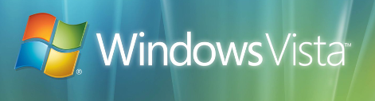
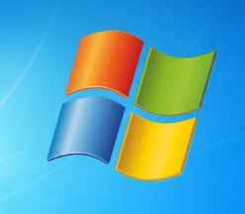
8. Windows Vista
a)It was released on January 30, 2007
b)Had an upgraded version of Graphical User Interface
c)First operating system to use DVD-ROM for installation
9. Windows 7
a)It was released on October 22, 2009
b)A large number of new features were introduced
c)Redesigned Windows shell with an updated taskbar
d)Incremental upgrade to the Windows line
e)Libraries were added in the file management system
f)A few features from the past Windows were removed
g)Extended hardware support

Slide 14
11) Windows 8
a)It was released for retail on October 26, 2012
b)Installed in new devices like Laptops, Mobile phones, tablets, etc.
c)Increased integration with cloud services
d)Windows Store service for software distribution
e)Task manager had been redesigned
f)New security features were introduced
g)Online Applications could be directly downloaded
12) Windows 10
a)It was released on July 29, 2015
b)Addresses shortcomings in the user interface first introduced with Windows8
c)A virtual desktop system
d)It had the ability to run windows store apps within windows on the desktop
e)rather than in the full-screen mode
f)Included new icons
g)To reduce storage shortcomings, Windows 10 automatically compresses the
file

Slide 15
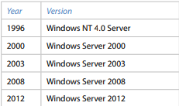
</Various Windows Servers/>
Microsoft’s first attempt at creating an operating system with network features was Windows 3.11, which came at the same time as Windows 3.1 (1992). Another name for Windows 3.11 is Windows for Workgroups, and this version had some additional features that gave network support:
1) Network cards and cables 
2) Sharing directories, disks and printers 
3) E-mail and instant messaging functionality

Slide 16
</Various commands on Windows/>
Computers run over a set of commands which are entered in the form of input, which with the advancement of Operating Systems can be entered through various Hardware devices.
Commands in Windows play a crucial role in interacting with the operating system, performing various tasks, and managing system resources efficiently. They provide users with a powerful way to control and customize their computing environment. Commands allow users to execute tasks quickly and automate repetitive operations, improving productivity and efficiency. Additionally, commands provide access to advanced system settings and administrative functions, enabling users to troubleshoot issues, configure system parameters, and perform maintenance tasks effectively. Whether it's managing files and directories, configuring network settings, or diagnosing system problems, Windows offer a versatile and essential toolset for users to navigate and control their computing experience

Slide 17
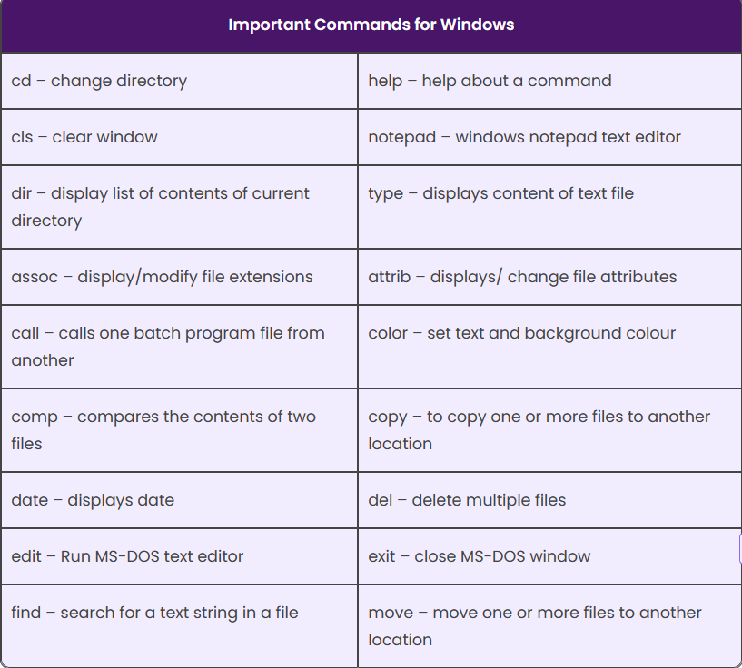
Given below are a few important MS-DOS Windows commands for reference:

Slide 18
</Working/>
02
Pitch Deck
20xx
1)Architecture Of Windows
2)Process synchronisation
3)Deadlock handling
4)Memory management
5)File management

Slide 19
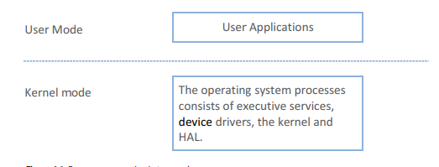
</Architecture of Windows/>
There are different ways to organize an operating system. One way is to create the operating system as a big application that runs on a computer such as a user application. However, this is not the way that modern operating systems were created, instead consisting of several layers, in which each layer has a specific task.
The architecture of the Windows operating system is a layered system with the two main components of user mode and kernel mode. User applications run in user mode, while processes belonging to the operating system run in kernel mode.

Slide 20
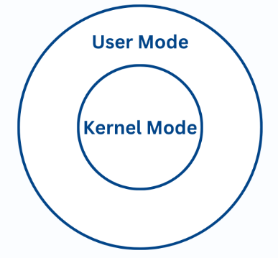
User mode
To protect the operating system from user applications, which can damage or critical alter data belonging to Windows operating system, applications runs in user mode. User mode also protects applications against each other.
Applications in user mode communicate with the kernel through the Windows API and access the hardware through the operating system. Applications in user mode cannot access data in other applications memory unless through Windows API.

Slide 21
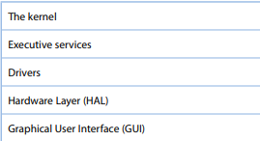
Kernel Mode
Processes in kernel mode have full access to the hardware and system resources. To get good security, processes in kernel mode runs in a protected area of memory.
The purpose of the kernel mode is to prevent applications in the user mode from being able to access critical areas of the operating system. Applications in the user mode must get help from the kernel mode to perform these kinds of operations

Slide 22
Windows Executive Services:
Executive Services are services in the Windows operating system that help applications in the user mode to run on the computer system. Executive services include many basic services in the Windows operating system.
The executive services in Windows are in kernel mode. he executive services do central services for the operating system, including the management of processes and threads, memory management and processing of input/output.
Some of the main components of the Windows Executive Services: 1)Object Manager
2)Configuration Manager
3)Process and thread Manager
4)Input/output Manager
5)Installation and Memory Manager
6)Cache Manager and Power Manager

Slide 23
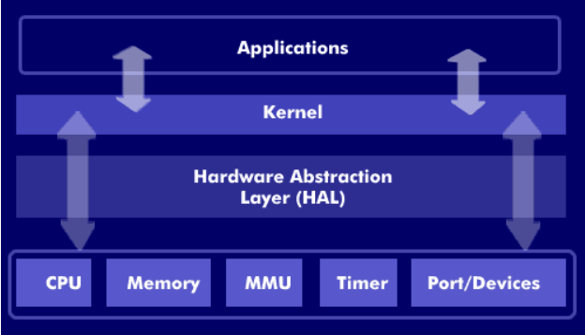
Hardware abstraction layer:
Hardware Abstractions are a set of routines that give applications access to hardware devices regardless of which manufacturer the equipment belongs to.
HAL is a layer between the physical hardware and the software that runs on the operating system. On a PC, HAL can be seen as a driver for the motherboard that allows instructions from high-level programming language to communicate with low-level components like hardware.
A task for HAL is to get the Windows operating system to be able to work with different hardware platforms.

Slide 24
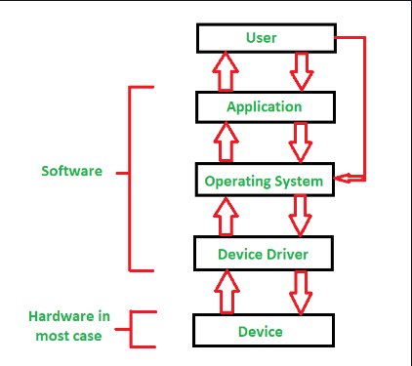
Device Drivers:
Device Drivers are small programs designed to help programs at a higher level to communicate with hardware.
Drivers are control programs that enable communication between hardware devices and the operating system, and are necessary for Windows to communicate with hardware. Device Drivers running in kernel mode, and provide an interface between the input/output manager and hardware.
There are several types of drivers. 
1)Drivers for hardware devices
2)File system drivers
3)File system filter drivers perform
4)Protocol drivers

Slide 25
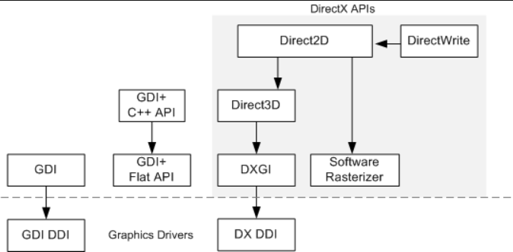
Windows Graphic system
A graphical user interface (GUI) is a type of interface that allows users to communicate with a computer in ways other than using the keyboard.
The window and graphics system implements the graphical user interfaces for Windows.
This system takes care of processing windows, drawing in windows, processing controls such as menus and toolbars, receiving mouse and keyboard input and more.

Slide 26
</Process Synchronisation/>
Process Synchronization is the coordination of execution of
multiple processes in a multi-process system to ensure that
they access shared resources in a controlled and predictable
manner. It aims to resolve the problem of race conditions and
other synchronization issues in a concurrent system.
Windows operating system is a multithreaded kernel that
provide support for real time application and multiprocessors.
On a uniprocessor system, Windows provides interrupt masks to
protect access to global resources. It protects access to
global resource using spinlock.

Slide 27
Inter process communication:
In Windows, inter process communication (IPC) allows processes to communicate and share data with each other, facilitating cooperation and coordination between different applications running concurrently on the system. Windows provides several mechanisms for inter process communication, each suited to different scenarios and requirements. Here are some commonly used IPC mechanisms in Windows:
1)Named Pipes:
Named pipes provide a communication channel between processes running on the
same machine or across a network. They support both synchronous and
asynchronous communication ,can be used for one-way or duplex communication.
Named pipes are often used for client-server communication, inter-process
communication, and communication between processes and services.
2.Windows Sockets (Winsock):
Windows Sockets (Winsock) is a standard API for network communication in
Windows. It enables processes to communicate over TCP/IP and other network
protocols.
Winsock provides a versatile and widely-used mechanism for inter process
communication, especially for client-server applications and networked
services.

Slide 28
3.Shared Memory:
Shared memory allows processes to share memory regions, enabling efficient and
high-speed data exchange. Processes can read from and write to shared memory
locations, avoiding the overhead of copying data between processes.
Shared memory is often used for inter process communication in performance
critical applications such as multimedia processing and real-time systems.
4.Message Queues:
Windows supports message queues for asynchronous communication between
processes. Processes can send messages to and receive messages from message queues, allowing for loosely-coupled communication.
Message queues are suitable for scenarios where processes need to exchange\
messages asynchronously ,such as event notification and interprocess coordination.
5.Remote Procedure Calls (RPC):
Remote Procedure Calls (RPC) enable processes to call functions or procedures
in other processes as if they were local, abstracting the complexities of
inter-process communication.
RPC is commonly used for distributed computing, client-server communication,
and inter-process communication in distributed systems.
6.Windows Communication Foundation (WCF):
Windows Communication Foundation (WCF) is a framework for building distributed
applications in Windows. It provides a unified programming model for various
communication protocols and supports a wide range of IPC scenarios.

Slide 29
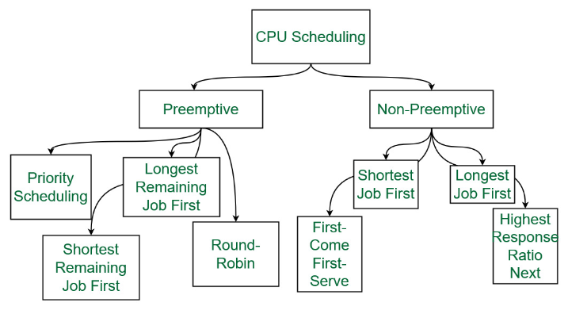
Scheduling algorithms used in Windows:
Process scheduling is the activity of deciding which
process should be performed first (or when), based on a
particular strategy/ algorithm. This activity is performed
by the process manager; as it removes an active process
from the CPU and selects another from the queue.
These are general algorithms used in Operating systems:
1)First-Come, First-Served
2)Shortest-Job-Next
3)Priority Scheduling
4)Shortest Remaining Time
5)Round Robin(RR) Scheduling
6)Multiple-Level Queues Scheduling

Slide 30
Scheduling algorithms by version in Windows
1)Windows3 uses Cooperative scheduler
2)Windows 95 , 98 Me Preemptive scheduler for 32-bit processes,
and cooperative for 16-bit processes.
Windows uses a round-robin technique with a multi-level feedback
queue for priority scheduling ever since NT,
3)Though in Vista there were some smart heuristic improvements to ensure that some processes, such as the disk defragmenter, are at a lower priority in order to not interfere with foreground processes.
4)Windows 7, 8 uses the same scheduler as Vista, though there may have been minor improvements.
5)Windows 10, Multilevel feedback queue algorithm have utilized scheduling algorithms like the Windows NT scheduler, which incorporates elements of preemptive priority-based scheduling, round-robin scheduling, and real-time scheduling to manage

Slide 31
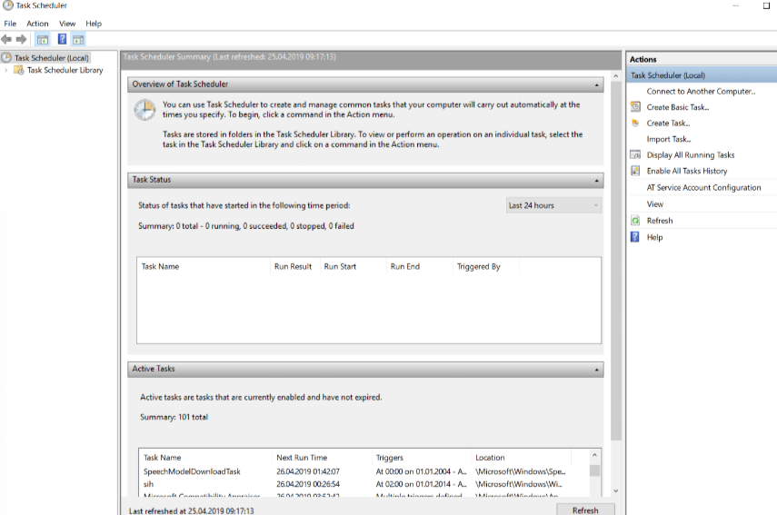
Task Scheduling
Task Scheduler is vital component of
Microsoft Windows that gives its users
capacity to plan initiation of projects or
programs at the user’s discretion or after
indicated time spans. This was firstly
introduced in “Microsoft Plus” for Windows
95 as “System Agent” however, it was
renamed to “Task Scheduler”. Windows Event
Log administration must be running before
Task Scheduler starts up. This
administration ought not to be mistaken
with scheduler, which is central part
of OS kernel that assigns CPU assets to
Measures previously running. Task Scheduler
administration works by controlling Tasks.

Slide 32
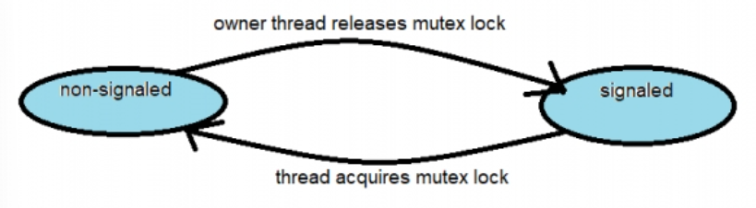
Synchronization mechanisms
1)Mutexes (Mutual Exclusion Objects):
Mutexes are synchronization objects used to ensure that only one thread
at a time can access a shared resource. In Windows, mutexes are implemented
using the HANDLE data type and can be created using functions such as
CreateMutex ,OpenMutex, and CloseHandle. Threads can acquire ownership of a
mutex using theWaitForSingleObject or WaitForMultipleObjects functions. If
mutex is owned by another thread, the requesting thread is blocked until the
mutex is released by the owning thread.

Slide 33
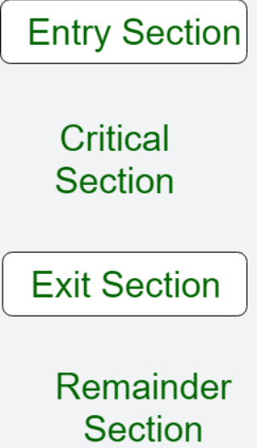
2)Critical Sections:
Critical sections are another synchronization mechanism
provided by Windows for mutual exclusion. When more than
one processes try to access the same code segment that
segment is known as the critical section. The critical section
contains shared variables or resources that need to be
synchronized to maintain the consistency of data variables.
They are lighter weight than mutexes and are typically used
For protecting access to small, frequently accessed sections
Of code. Critical sections are implemented using the CRITICAL
SECTION data type and associated functions such as
InitializeCriticalSection , EnterCriticalSection, and
LeaveCriticalSection.
3)Events:
Events are synchronization objects that allow threads to signal and wait
for certain conditions to occur. Windows provides manual-reset events and
auto-reset events. Manual-reset events remain signaled until explicitly

Slide 34
Reset by a thread, while auto-reset events automatically reset
after a single waiting thread is released. Events are created
using functions such as CreateEvent, OpenEvent, and
CloseHandle, and they are manipulated using functions like
SetEvent and ResetEvent.
4)Semaphores:
Semaphores are synchronization objects used for controlling
access to a pool of resources. In Windows, both counting
semaphores and binary semaphores are available.
Counting semaphores allow a specified number of threads to
access a resource concurrently, while binary semaphores
restrict access to only one thread at a time. Semaphores are
created using functions such as CreateSemaphore, OpenSemaphore,
and CloseHandle, and they are manipulated using functions like
ReleaseSemaphore and WaitForSingleObject.

Slide 35
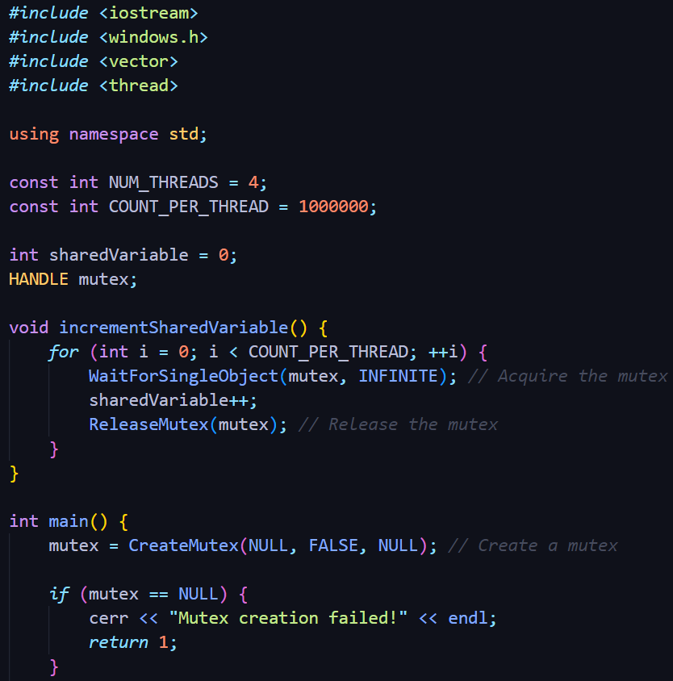
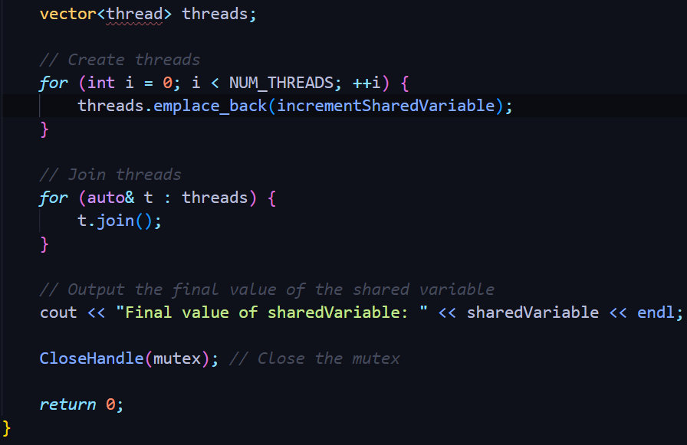
Potential code:

Slide 36
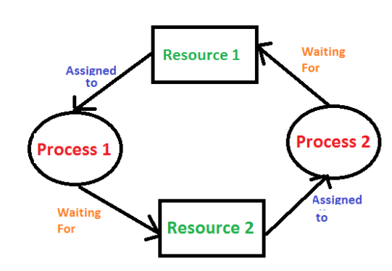
</Deadlock Handling in Windows/>
A deadlock is a situation where a set of processes are blocked because each process is holding a resource and waiting for another resource acquired by some other process.
Conditions for Deadlock:
1)Hold and Wait
2)No Pre Emption
3)Mutual Exclusion
4)Circular Wait

Slide 37
Deadlock Avoidance: Windows employ avoidance techniques to prevent deadlocks from occurring in the first place. This involves carefully scheduling processes and managing resource allocation to minimize the likelihood of deadlock situations. Resource Preemption: In some cases, Windows may preemptively revoke resources from processes to resolve potential deadlocks. The operating system can forcibly release resources from one or more processes to allow others to proceed, thereby preventing or resolving deadlocks. Windows also allows developers to implement their own deadlock prevention and handling mechanisms within their applications. Developers can use synchronization primitives provided by windows, such as locks and semaphores, to manage resource access and prevent deadlocks at the application level.

Slide 38
Deadlock Detection and Recovery: Resource Allocation Graph - Windows employs a graph-based algorithm to detect potential deadlocks. It utilizes a resource allocation graph to identify cycles that indicate a potential deadlock. Once a deadlock is detected, Windows takes appropriate actions to break the deadlock and allow processes to proceed. Windows also use a timeout mechanism to detect deadlocks. If a resource is not released within a certain time, Windows assumes a deadlock and takes necessary recovery actions. It can terminate one or more processes involved in the deadlock or force the release of resources to break the deadlock. Deadlock Prevention: Windows emphasizes a prevention-oriented approach by ensuring that the necessary conditions for deadlocks are not allowed to occur. It achieves this by employing techniques such as resource ordering, which ensures that resources are requested and released in a specific order, thereby preventing circular waits.

Slide 39
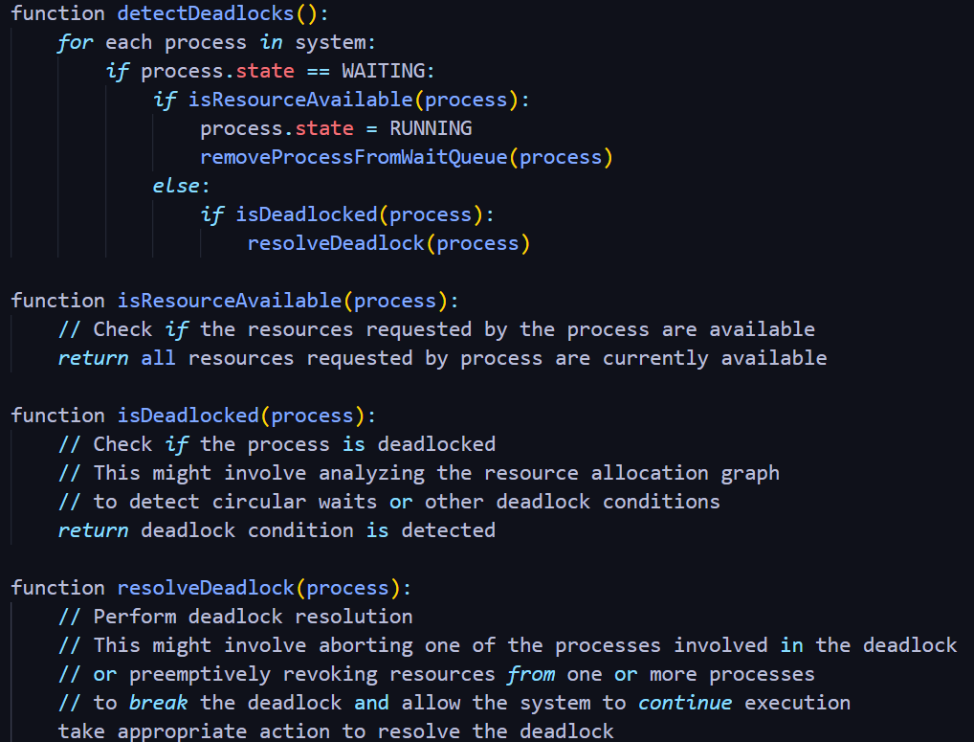
Potential code:

Slide 40
</Memory management/>
In a multiprogramming computer, the Operating System resides
in a part of memory, and the rest is used by multiple
processes. The task of subdividing the memory among different
processes is called Memory Management. Memory management is a
method in the operating system to manage operations between
main memory and disk during process execution. The main aim of
memory management is to achieve efficient utilization of
memory.
There are two memory management approaches: swapping and
virtual memory. The difference between them is the way in
which a process is loaded to the main memory.

Slide 41
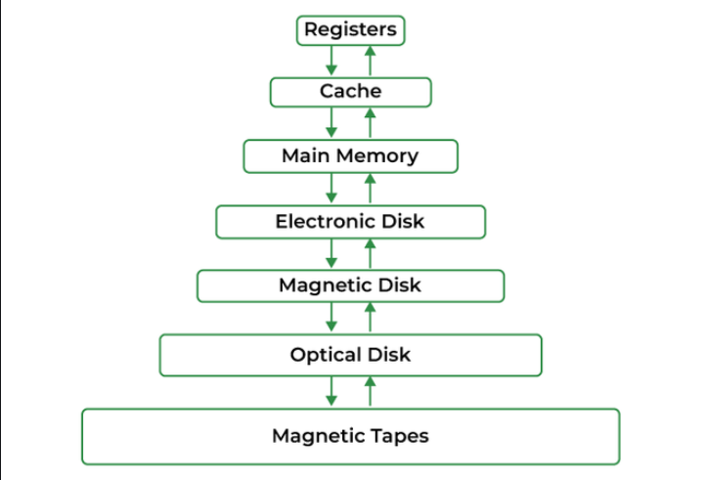
Why Memory Management is Required?
1)Allocate and de-allocate memory before and after process execution.
2)To keep track of used memory space by processes.
3)To minimize fragmentation issues.
4)To proper utilization of main memory.
5)To maintain data integrity while executing of process
Memory hierarchy:

Slide 42
Logical and Physical Address Space
1)Logical Address Space: An address generated by the CPU is known as a “Logical Address”. It is also known as a Virtual address. Logical address space can be defined as the size of the process. A logical address can be changed.
2)Physical Address Space: An address seen by the memory unit (ie the one loaded into the memory address register of the memory) is commonly known as a “Physical Address”. A Physical address is also known as a Real address. The set of all physical addresses corresponding to these logical addresses is known as Physical address space. A physical address is computed by MMU. The run-time mapping from virtual to physical addresses is done by a hardware device Memory Management Unit(MMU). The physical address always remains constant.

Slide 43
Static and Dynamic Loading
Loading a process into the main memory is done by a loader. There are
two different types of loading :
1)Static Loading: Static Loading is basically loading the entire program into a fixed address. It requires more memory space.
2)Dynamic Loading: The entire program and all data of a process must be in physical memory for the process to execute. So, the size of a process is limited to the size of physical memory. To gain proper memory utilization, dynamic loading is used. In dynamic loading, a routine is not loaded until it is called. All routines are residing on disk in a relocatable load format. One of the advantages of dynamic loading is that the unused routine is never loaded. This loading is useful when a large amount of code is needed to handle it efficiently.

Slide 44
Static and Dynamic Linking
To perform a linking task a linker is used. A linker is a program that
takes one or more object files generated by a compiler and combines them
into a single executable file.
1) Static Linking: In static linking, the linker combines all necessary program modules into a single executable program. So there is no runtime dependency. Some operating systems support only static linking, in which system language libraries are treated like any other object module.
2) Dynamic Linking: The basic concept of dynamic linking is similar to dynamic loading. In dynamic linking, “Stub” is included for each appropriate library routine reference. A stub is a small piece of code. When the stub is executed, it checks whether the needed routine is already in memory or not. If not available then the program loads the routine into memory.

Slide 45
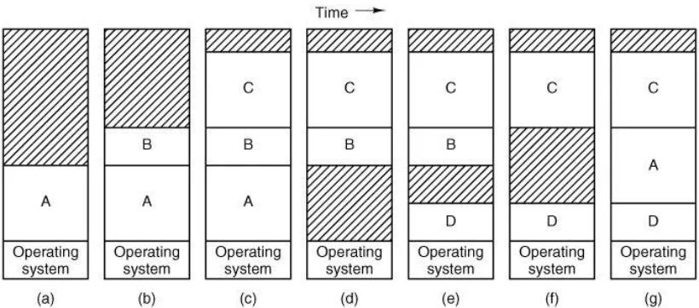
There are two memory management approaches swapping and virtual memory.
The difference between them is the way in which a process is loaded to
the main memory.
Swapping
Swapping is a process of swapping a process temporarily into a secondary
memory from the main memory, which is fast compared to secondary memory. A
swapping allows more processes to be run and can be fit into memory at one
time. The main part of swapping is transferred time and the total time is
directly proportional to the amount of memory swapped.

Slide 46
A is now at a different location, addresses contained in it must be relocated,
either by the software when it is swapped in or (more likely) by hardware
during program execution
When swapping creates multiple holes in memory, it is possible to combine them
all into one big one by moving all the processes downward as far as possible.
This technique is known as memory compaction. It is usually not done because
it requires a lot of CPU time. For example, on a 1-GB machine that can copy at
a rate of 2 GB/sec (0.5 nsec/byte), it takes about 0.5 sec to compact all of
the memory. That may not seem like much time, but it would be noticeably
disruptive to a user watching a video stream.
A point that is worth making concerns about how much memory should be
allocated for a process when it is created or swapped in. If processes are
created with a fixed size that never changes, then the allocation is simple:
the operating system allocates exactly what is needed, no more and no less.

Slide 47
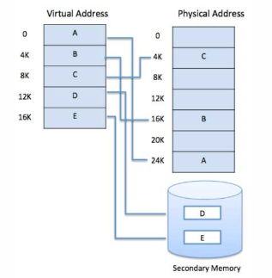
Virtual Memory
Virtual memory is a memory management technique where secondary memory can be used as if it were a part of the main memory. Virtual memory is a common technique used in a computer's operating system (OS).
Virtual memory uses both hardware and software to enable a computer to compensate for physical memory shortages, temporarily transferring data from random access memory (RAM) to disk storage. Mapping chunks of memory to disk files enables a computer to treat secondary memory as though it were main memory

Slide 48
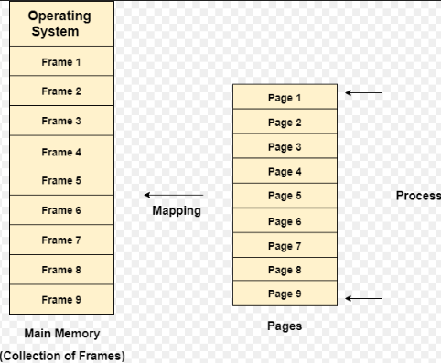
Paging
On any computer, there exists a set of memory
Addresses that programs can produce. When
program uses an instruction like
MOV REG, 1000
It does this to copy the contents of memory
Address 1000 to REG (or vice versa , depending on
The computer). Addresses can be generated using
indexing, base registers, segment registers, and
other ways.These program-generated addresses are
called virtual addresses and form the virtual
address space. On computers without virtual
memory, the virtual address is put directly onto
the memory bus and causes the physical memory
word with the same address to be read or written.

Slide 49
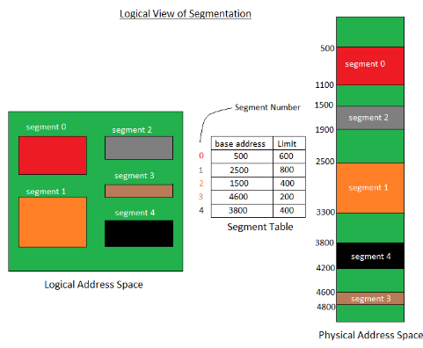
Segmentation
The virtual address space is a collection of segments. Each segment has a name and a length. Thus the addresses specify both the segment name and the offset within that segment. The user, therefore, specifies each address by two quantities: a segment name and an offset. Contrast this scheme with the paging one, in which the user specifies only a single address which is partitioned by the hardware into a page number and an offset, all invisible to the programmer.
Segments are numbered and are referred to by a segment number rather than by a segment name. That’s the reason why a logical address in the segmentation approach consists of two tuples:
<segment-number, offset>

Slide 50
</In windows/>
Memory management in windows uses the virtual memory architecture . Each
process has a virtual address space , which is divided into pages. It has a
virtual memory manager that uses paging, so that only active parts of
programs are loaded into the memory when they run. Windows supports Demand
Paged Virtual Memory. This means that the operating system only loads pages
into memory that a running processrequests.
A Cache Manager keeps track of virtual addresses used to map files into the
Memory .This improves the input/output performance for many applications
because read operations can be done without using the hard drive. In today’s
Windows, Win32 and Win64 coexist. Win32 has a 32-bit memory structure that
uses pointers with 32-bit memory addresses, whereas Win64 has the
opportunity for a much larger virtual address space because Win64 uses 64
bit pointers.

Slide 51
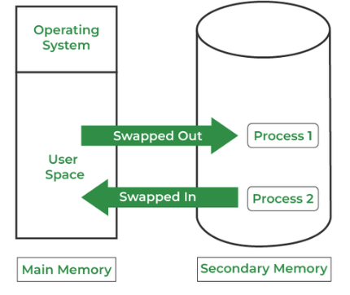
Memory manager
The Memory Manager in Windows takes care of the memory management. It allocates space for programs in memory when needed, and it removes programs from memory again when they finish. Memory Manager implements virtual memory, perform tasks on the memory and gives support for large memories. Memory Manager also creates services such as keeping track of files that are part of the memory and gives support to the Cache Manager. he Memory Manager has system services that allocate and free virtual memory, shares memory between processes and manages pages. Memory Manager also has many services that allocate and free physical memory.

Slide 52
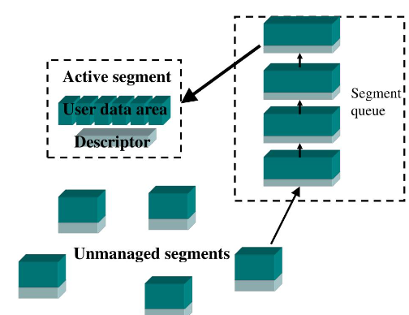
Heap manager
Dynamic memory allocation is a method used to allocate memory to processes running on a computer. he heap is a portion of the memory used for dynamic memory allocation. Programmers can use the heap to store variables and objects. Variables and objects created in the heap will be there until deleted by the process or by the Garbage Collector. Windows divides the memory into heaps. When each thread has a free heap, there will be no competition for the memory between threads, which increases system performance. Each process has at least one free heap. Once the process starts, it creates a heap called the Default Process Heap, which exists until the process is completed. Processes can also create additional private free heaps using a Windows API function called HeapCreate.

Slide 53
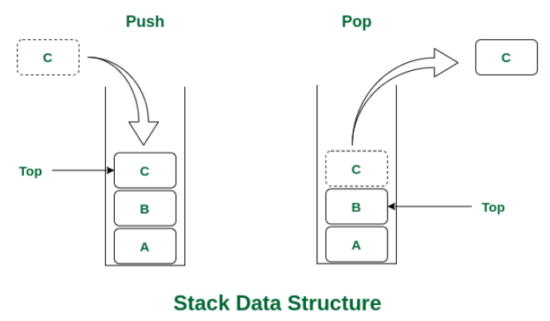
Stacks
When a thread is running, it must have access to a temporary storage where it can store local variables, have function parameters and return addresses for function calls. A stack is a portion of the memory used for this. A stack is a last-in, first-out data structure. A new element is always added at the top of a stack, and when removing an item from a stack, the top item is always removed. Items at the bottom of a stack will therefore be there until all the items over it are removed. he Memory Manager in Windows uses two stacks for each thread, a user stack and a kernel stack. When a thread is created, it will automatically get a user stack and a kernel stack. User stacks generally has a size of 1MB, while kernel stacks are often much less, with a common size being 12 KB

Slide 54
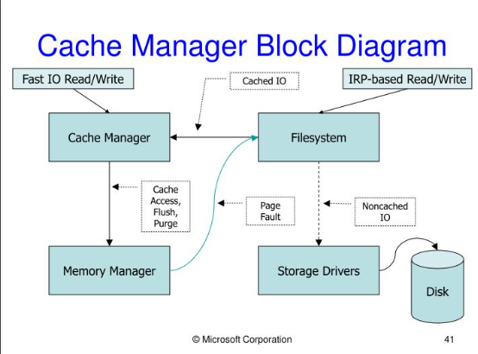
Cache manager
The Cache Manager in Windows takes care
of the organization of caching. The
Cache Manager consists of a set of
functions in kernel mode, as well as
threads that cooperate with the Memory
Manager. An important task for the Cache
Manager is to ensure that processes that
are trying to obtain data get the latest
version of the data, and not older
versions.
The Cache Manager provides a high-speed
intelligent mechanism to reduce
input/output for disk drives and improve
computer system performance

Slide 55
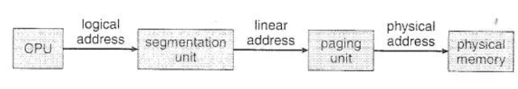
Architecture’s strategy
The architecture allows a segment to be as 4GB and the maximum
number of segments per process is 16KB. The logical address space is
divided into two partitions. The first one consists of up to 8KB
segments that are private to that process. The second consists of up to
8KB segments that are shared among all the processes. About the paging,
a page size is either 4 KB or 4 MB.

Slide 56
</File Management/>
File management in an operating system refers to the set of processes and techniques involved in creating, organizing, accessing, manipulating, and controlling files stored on storage devices such as hard drives, solid-state drives, or network storage. It encompasses a range of tasks and functionalities that ensure efficient handling of files, including their creation, deletion, naming, classification, and protection.
File management serves as the intermediary layer between applications and the underlying storage hardware, providing a logical and organized structure for storing and retrieving data.

Slide 57
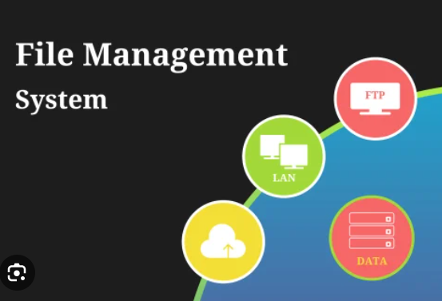
Objectives of File Management in Operating System:
1)File organisation
2)Data security
3)Data sharing
4)File backup
5)File compression
6)File encryption
7)File retrieval
8)Space management
9)File versioning
10)File Auditing

Slide 58
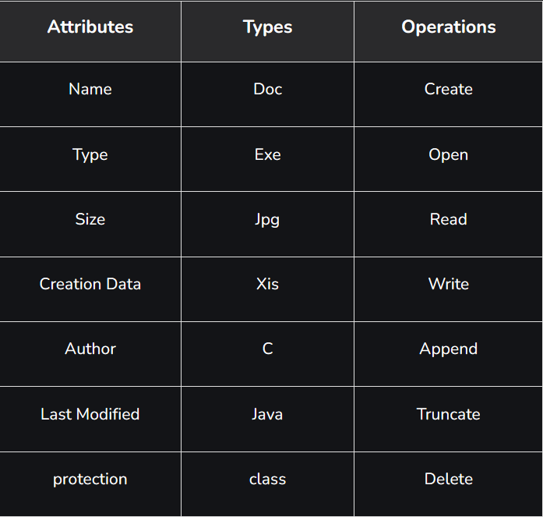
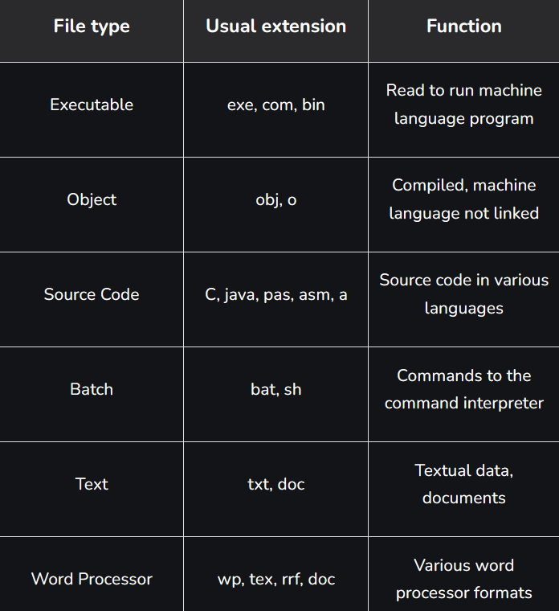
File attributes

Slide 59
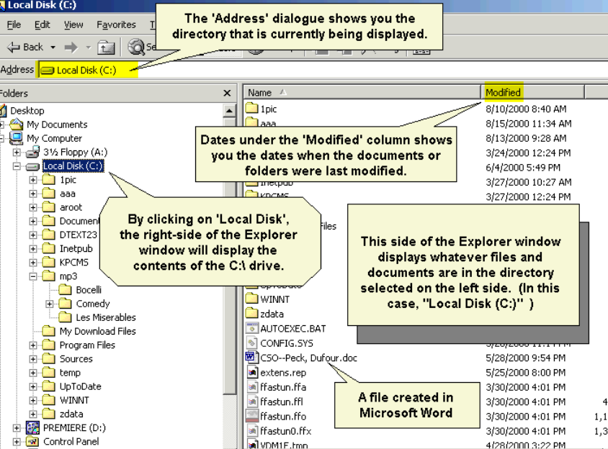
File directories
The collection of files is a file directory. The directory contains
Information about the files, including attributes, location, and
ownership. Much of this information, especially that is concerned with
storage, is managed by the operating system. The directory is itself a
file, accessible by various file management routines.
1)Information contained in a device directory.
2)Name
3)Type
4)Address
5)Current length
6)Maximum length
7)Date last accessed
8)Date last updated
9)Owner id
10)Protection information

Slide 60
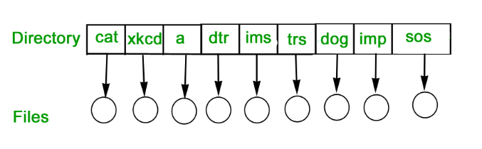
Levels of directory
1)Single level
In this, a single directory is maintained for all the users.
It leads to 2 problems:-
a)Naming problem: Users cannot have the same name for two files.
b)Grouping problem: Users cannot group files according to their needs.

Slide 61
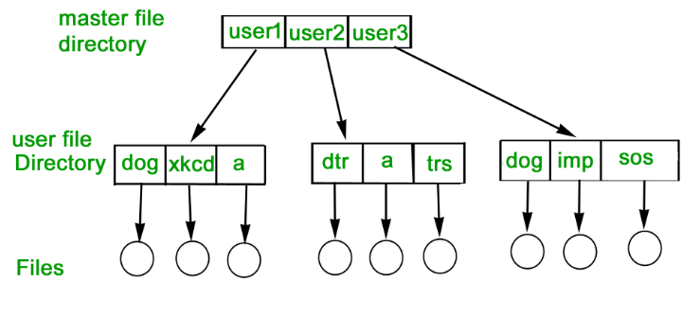
2)Two-Level Directory
In this separate directories for each user is maintained.
Path name: Due to two levels there is a path name for every file to
locate that file.
Now, we can have the same file name for different users.
Searching is efficient in this method.

Slide 62
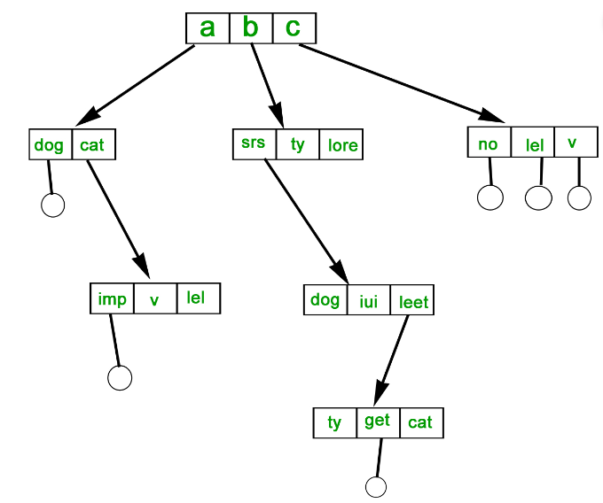
Tree-Structured Directory
The directory is maintained in the form of a tree. Searching is efficient
and also there is grouping capability. We have absolute or relative path
name for a file.

Slide 63
Types of File Management in Operating System
There are several types of file management in operating systems, including:
1)Sequential File Management: In a sequential file management system, files are stored on
storage devices in a sequential manner. Each file occupies a contiguous block of storage
space, and accessing data within the file requires reading from the beginning until the
desired location is reached. This type of file management is simple but can be
inefficient for random access operations.
2)Indexed File Management: Indexed file management utilizes an index structure
to improve file access efficiency. In this system, an index file is created alongside
the main data file, containing pointers to various locations within the file. These
pointers allow for quick navigation and direct access to specific data within the file.
3)Direct File Management: Direct file management, also known as random access file
management, enables direct access to any part of a file without the need to traverse the
entire file sequentially. It utilizes a file allocation table (FAT) or a similar data
structure to keep track of file locations. This approach allows for faster and more
efficient file access, particularly for larger files.

Slide 64
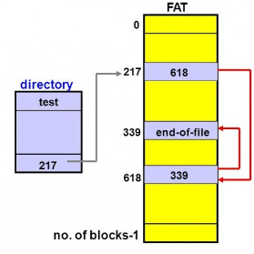
In Windows
File Allocation Table
is the file system used in MS-DOS and early versions of Windows. here have been several versions of FAT, including FAT12, FAT16, FAT32 and exFAT. FAT12 was a 12-bit address system designed for floppy disks, while FAT16 was developed when PCs with hard disks were taken in use. he first versions of MS-DOS and the very first versions of Windows used FAT12 and FAT16, which are no longer in use. he early versions of the Windows operating system were Windows 95, Windows 98 and Windows Millennium, all of which used FAT32, and which is no longer in general use. exFAT, which is also called FAT64, is a newer version of FAT. exFAT is designed for smaller storage devices such as USB pens, so is therefore a version of FAT still in use.

Slide 65
NT File System
The NT File System (NTFS) is the file system developed for Windows NT, and is the
file system that current versions of Windows use. NTFS supports long file names,
security, fault tolerance, encryption, disk compression and very large files and
volumes. NTFS has several advantages over FAT32 when it comes to safety,
reliability, extensibility and efficiency
Safety Security is enhanced by the fact that users are given access to just the
directories and files they need. In FAT32, all users could access all the files on a
hard disk
Reliability NTFS keeps track of changes in the file system by keeping a journal. NTFS
uses log files to keep track of all disk activity, which allows an NTFS volume to
recover quickly after a disk crash
Extensibility Using NTFS formatted volumes can expand the storage capacity to existing
volumes without having to take backup, to repartition, to reformat or to restore
anything
Compression NTFS supports the compression of files and directories. You can create a
file as compressed, and then NTFS automatically compresses the contents of the file

Slide 66
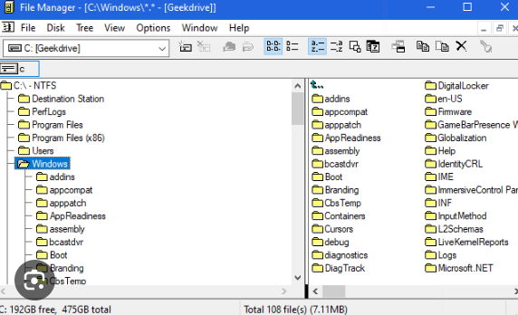
Windows explorer
File management in windows can be done
through Windows explorer or My Computer.
Windows Explorer displays the
hierarchical list of files, folders, and
storage drives (both fixed and
removable) on your computer Windows
Explorer can be used to copy, move,
rename, and search for files and
folders. Files or folders deleted from a
removable storage media such as network
drive are permanently deleted and are
not sent to the Recycle Bin.

Slide 67
</Security/>
03
Pitch Deck
20xx
1)Security and protection
2)Why Windows is vulnerable to malware

Slide 68
</Security and Protection/>
Security measures prevent unauthorized access or interference with computer resources, ensuring data and programs are used as intended and only by authorized users. Security measures deal with threats to resources that come from outside a computer system, while protection measures deal with internal threats. Passwords are the principal security tool.
Security can be attacked in the following ways:
1)Trap doors: Hidden vulnerabilities intentionally inserted into software, allowing unauthorized access.
2)Line tapping: Unauthorized interception of data transmitted over communication lines.
3)Electronic data captures: Illegitimate collection of data electronically without authorization.
4)Lost line: Disruption or loss of a communication line, potentially leading to data loss or unauthorized access.
5)Rouge software: Malicious or unauthorized software that operates on a system without user consent, posing security risks.

Slide 69

Goals of Security system:
1)Integrity
2)Secrecy
3)Availability
Threats to operating system:
1)Program threats
a)Virus: Malicious software that spreads by attaching to files or programs, causing various types of damage.
b)Trojan Horse: Malicious software that disguises itself as legitimate programs to trick users into downloading and executing it, enabling harmful actions.
c)Logic Bomb: Code inserted into software to execute a malicious action under specific conditions, often used for sabotage or data destruction.
2)System threats
a)Worm: Self-replicating malware that spreads across networks, exploiting vulnerabilities and causing widespread damage.
b)Denial of service (DoS): Malicious attempts to disrupt computer systems or networks by overwhelming them with traffic or requests, rendering them inaccessible to legitimate users.

Slide 70
Security in Windows NT:
1)Secure login - Users must enter a password to log in, and the "Ctrl+Alt+Delete" key combination ensures the login screen is genuine, preventing fake login attempts by malicious software.
2)Access control to file File owners can decide who can access their files, maintaining privacy and security.
3)Address space defence – Each program has its own protected memory space, preventing unauthorized access between programs and safeguarding against data theft.
4)Clearance of pages – Windows NT clears out old data from memory pages, making it difficult for spyware to access sensitive information left behind.
5)Auditing – Windows NT records system events like login attempts and file access in log files, allowing administrators to monitor for suspicious activity and security breaches.

Slide 71
Virus and threat protection
1)Microsoft Defender Antivirus - Built-in security guard for your computer, always scanning for viruses and malware in the background. It updates itself automatically to stay effective.
2)Local Security Authority – is responsible for authenticating users and verifying Windows logins. LSA handles tokens and credentials such as passwords that are used for single sign-on to a Microsoft account and Azure services . Acts like a bouncer at the club entrance, verifying the identity of users logging into Windows. Manages passwords and ensures system security
3)Attack surface reduction - Adds extra barriers to your computer's defenses, making it harder for cyber attackers to sneak in. Provides default protection for Windows 11 , added support for non-UEFI(Unified extensive firmware interface) lock and policy management controls via MDM and group policy.
4)Controlled folder access - Functions like a secure box for your important files, allowing only trusted apps to access specific folders. Protects your documents and pictures from unauthorized access or tampering.

Slide 72
Network security
1)Transport layer security - TLS is a cryptographic protocol that encrypts internet communications, ensuring privacy and security. Windows 11 uses
TLS 1.3, the latest version, to safeguard online activities such as shopping and banking automatically.
2)Domain name system -DNS with HTTPS encrypts internet requests, similar to sealing letters in envelopes, preventing eavesdropping on website visits. Windows 11 employs this feature to ensure private and secure internet browsing.
3)Opportunistic Wireless Encryption – is a technology that allows wireless devices to establish encrypted connections to public Wi-Fi hotspots.
4)Server message block - SMB secures file sharing on networks, similar to a secure safe. Windows 11 enhances this security with additional encryption, protecting shared files from unauthorized access and data theft, particularly over the internet.

Slide 73
Encryption and data protection:
1)Bitlocker management - BitLocker is like putting a lock on your computer to keep your files safe. With BitLocker management, a special tool helps manage these locks, making sure only the right people can access your computer and its files.
2)Bitlocker enablement – BitLocker enablement is like turning on the security system in your house. It encrypts your computer's hard drive, making it unreadable to anyone who doesn't have the right key. This feature ensures that even if your computer is lost or stolen, your data remains safe from prying eyes.
3)Encrypted hard drive – Imagine your hard drive is like a safe with its own built-in lock. Encrypted hard drives automatically scramble your data so that only you can unlock it with the right key. It's like having a personal bodyguard for your files.
4)Personal data protection - Windows 11 works together with BitLocker and other security features to protect your personal files. It's like having a team of guards protecting your documents and photos, making sure they stay safe even if someone tries to access them without permission.

Slide 74
</Why Windows is so vulnerable to malware />
According to Atlas VPN, 59.8 million malware samples were detected on Windows operating systems in the first three quarters of 2022. This makes up for roughly 95.6% of all malware cases detected during the same time frame.
Reason:
Windows is by far the most common operating system on devices worldwide; therefore, Windows is the operating system most targeted by bad guys, simply from an efficiency standpoint. Also, since so many devices around the world are running Windows, when malware spreads, the number of systems infected can quickly become enormous.
Also compared to an operating system like Mac with a dedicated and safe library for application downloads, Windows users must, for the most part, download applications via a standard internet browser, a connection that is much more vulnerable to attack. Thus , it is must for users to purchase a third party software.

Slide 75
What to do if Windows get Corrupted?
Windows becomes corrupted when it experiences damage or changes
to some of the files that constitute the operating system. This
can happen for a number of reasons, such as:
a)Power outage or other unexpected interruption during a Windows update
b)Virus or malware infection
c)Hardware failure, such as a bad hard drive sector
d)Human error, such as accidentally deleting a system file
Methods to fix:
1)Try System Restore
2)Scan for Viruses/Malware
3)Use the SFC /scannow command - In the Command Prompt window, type “sfc /scannow” and hit Enter. This will initiate the scanning process. Once the scan is finished, the utility will display the results. If the scan will find any issues, the tool will attempt to repair the corrupted files automatically. Restart your computer afterwards
4)Reinstall Windows

Slide 76
</Features/>
04
Pitch Deck
20xx
1)Features explicit to Windows
2)How Windows captured the world

Slide 77
</Features explicit to Windows/>
1)Windows Defender: Built-in antivirus and anti-malware software designed to
protect the system against various threats such as viruses, spyware, and
ransomware.
2)Windows Hello: Biometric authentication feature that allows users to log
in to their devices using facial recognition, fingerprint, or iris
scanning.
3)Cortana: Microsoft's virtual assistant that provides voice-controlled
assistance for tasks such as searching the web, setting reminders, and
managing calendar events.
4)DirectX: Collection of APIs designed to handle tasks related to
multimedia, especially gaming and video playback, providing enhanced
performance and graphical capabilities.
5)Windows Subsystem for Linux (WSL): Feature that allows users to run Linux
binaries natively on Windows without the need for a virtual machine,
enabling developers to use Linux tools and utilities alongside Windows
applications.

Slide 78
6)Windows Update: Automatic updating system that delivers security patches,
bug fixes, and feature updates to keep the operating system up-to-date and
secure.
7)BitLocker: Full-disk encryption feature that helps protect data stored on
the system's hard drive or SSD, ensuring that it remains encrypted and
secure even if the device is lost or stolen.
8)Task View: Feature that provides a virtual desktop interface, allowing
users to organize and switch between multiple desktops, each with its own
set of open windows and applications.
9)OneDrive Integration: Integration with Microsoft's cloud storage service,
oneDrive, enabling users to sync files and folders across multiple devices
and access them from anywhere with an internet connection.
10)Windows Sandbox: Feature that allows users to run applications in an isolated environment, providing a safe testing ground for potentially harmful software without risking damage to the host system

Slide 79
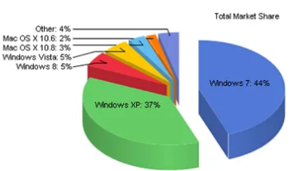
</How Windows captured the world/>
1)User-Friendly Interface: Windows introduced a graphical user interface(GUI)
that was intuitive and easy to use, especially compared to earlier command
line interfaces. This made computing more accessible to a broader audience,
including non-technical users.
2)Software Compatibility: Windows provided extensive compatibility with a wide
range of software applications. Developers were drawn to the platform due to
its large user base and robust development tools, resulting in a rich
ecosystem of third-party software for Windows.

Slide 80
3)Marketing and Partnerships: Microsoft invested heavily in marketing and
formed partnerships with hardware vendors and software developers to
promote Windows. Bundling Windows with new PCs and offering licensing deals
helped drive adoption among consumers and businesses.
4)Continuous Improvement: Microsoft continuously updated 4and improved
Windows with new features, performance enhancements, and security updates.
regular releases of new versions ensured that Windows remained competitive
and relevant in a rapidly evolving industry.
5)Enterprise Adoption: Windows became the standard operating system in
enterprise environments due to its reliability, manageability, and
compatibility with business software. Microsoft offered enterprise-focused
editions of Windows with features tailored to corporate IT needs.
6)Global Reach: Windows expanded its market reach globally, adapting to
different languages, cultures, and regulatory requirements. Localized
versions of Windows made it accessible to users worldwide, further fueling
its popularity.

Slide 81
</Conclusion/>
05
Pitch Deck
20xx
1)Future
2)Sum up
3)Sources
4)Software used

Slide 82
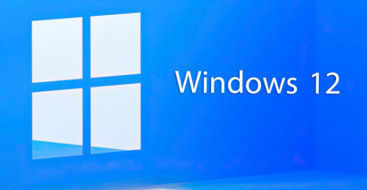
</Future/>
Windows 12
The next version of Windows include that the OS will have more artificial intelligence (AI) built in, that it will switch to a lightweight modular code, and that its codename is Hudson Valley. But Bowden's latest thinking points to Windows 12 not coming in 2024.

Slide 83
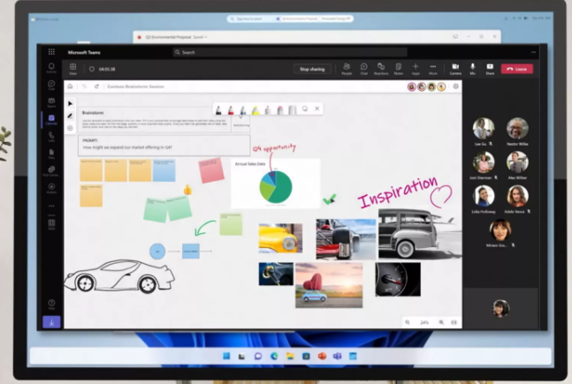
A Peek at the Windows 12 Desktop at Ignite
A peek of potential Windows 12 came at Microsoft Ignite, a conference that
focuses on the IT community. The company let slip a Windows desktop interface
with an altered appearance, which many have assumed represents what we’ll see
in Windows 12.

Slide 84
Windows 12 Will Have More Built-In AI
Windows 11's 23H2 update last October brought powerful new A
tools in the form of Windows Copilot. It's already impressive and
powerful, though it could stand to have more abilities to actually
control your PC. These kind of user-facing predictive and
assistive tools should only get stronger in Windows 12. AI
technology can also improve back-end things like code stability and
update delivery.
Prior to Copilot, Windows' Search panel and the default Edge web
browser included the new and conversational search powered by AI.
A recent Windows Insider blog post mentioned a Recommended section
in File Explorer that suggests files and folders you’re likely to
want to open. The feature is noted as being for users signed in to
Active Directory accounts, but I could see it coming to anyone with
a OneDrive login.

Slide 85
</Sum Up/>
Therefore to sum up,
Windows, crafted by Microsoft, stands as a ubiquitous operating system celebrated for its intuitive interface, expansive hardware compatibility, and diverse software ecosystem. It boasts essential features like Windows Defender for security, Cortana for assistance, and DirectX for multimedia enhancements. Catering to a spectrum of needs, from personal to enterprise use, Windows continually evolves with regular updates. Its enduring presence underscores its status as a cornerstone of modern computing, empowering users globally with innovation and reliability.

Slide 86
</Sources/>
1)Geeks for geeks
2)Tutorials point
3)Linkedin
4)Fox news
5)Byjus
6)learn.Microsoft
7)Introduction to Windows
8)Various articles

Slide 87
</Software/ Resources used/>
1)Slidesgo
2)Vs code
3)Microsoft office

Slide 88
Thank you

